Slide 1
Ethics in Information Technology, Fourth Edition
Chapter 5
Freedom of Expression
Notes:
‹#›

Slide 2
Objectives
As you read this chapter, consider the following questions:
What is the basis for the protection of freedom of expression in the United States, and what types of expression are not protected under the law?
What are some key federal laws that affect online freedom of expression, and how do they impact organizations?
What important freedom of expression issues relate to the use of information technology?
Ethics in Information Technology, Fourth Edition
‹#›
Notes:
‹#›

Slide 3
Freedom of Expression and Internet
Internet Enables
News – ideas-rumors-information
Open discussions – anonymity
Ethical use of this freedom and power
Government and organizations have made laws and policies to guide people in this and protect their own interest
Right of freedom of expression
First amendment guarantee this right
Several federal/state laws found unconstitutional
Ethics in Information Technology, Fourth Edition
‹#›
Notes:
‹#›

Slide 4
First Amendment Rights
Definition of free speech includes:
Nonverbal, visual, and symbolic forms of expression
Right to speak anonymously
A speech highly unpopular for majority – protection of minority views
Ethics in Information Technology, Fourth Edition
‹#›
Notes:
‹#›

Slide 5
First Amendment Rights (cont’d.)
Not protected by the First Amendment
Perjury
Fraud
Defamation
Obscene speech
Incitement of panic
Incitement to crime
“Fighting words”
Sedition
Obscene speech and Defamation relevant to IT
Ethics in Information Technology, Fourth Edition
‹#›
Notes:
‹#›

Slide 6
Obscene Speech
Based on Miller v. California, speech is considered obscene when:
Lacks serious literary, artistic, political, or scientific value
Ethics in Information Technology, Fourth Edition
‹#›
Notes:
‹#›

Slide 7
Defamation
Oral or written statement of alleged fact that is:
False
Harms another person
Harm is often of a financial nature
Slander
Oral defamatory statement
Libel
Written defamatory statement
Care in online communication to avoid charges of defamation
Organizations prepared to take actions against libelous attacks
Ethics in Information Technology, Fourth Edition
‹#›
Notes:
‹#›

Slide 8
Freedom of Expression: Key Issues
Controlling access to information on the Internet
Anonymity on the Internet
Defamation and hate speech
Corporate blogging
Pornography
Ethics in Information Technology, Fourth Edition
‹#›
Notes:
‹#›

Slide 9
Controlling Access to Information on the Internet
Freedom of speech on the Internet is complicated by ease by which children can access Internet
Laws and software to block questionable material
Communications Decency Act (CDA 1996)
Aimed at protecting children from pornography
Broad language and vague definition of indecency
Found unconstitutional in 1997
Ethics in Information Technology, Fourth Edition
‹#›
Notes:
‹#›

Slide 10
Controlling Access to Information on the Internet (cont’d.)
Child Online Protection Act (COPA 1998)
Applies to communication for commercial purposes
Imposes penalties for exposing minors to harmful material on the Web
Found unconstitutional in 2004
Internet filtering
Software installed with a Web browser
Blocks access to certain Web sites deemed to contain inappropriate or offensive material
Ethics in Information Technology, Fourth Edition
‹#›
Notes:
‹#›

Slide 11
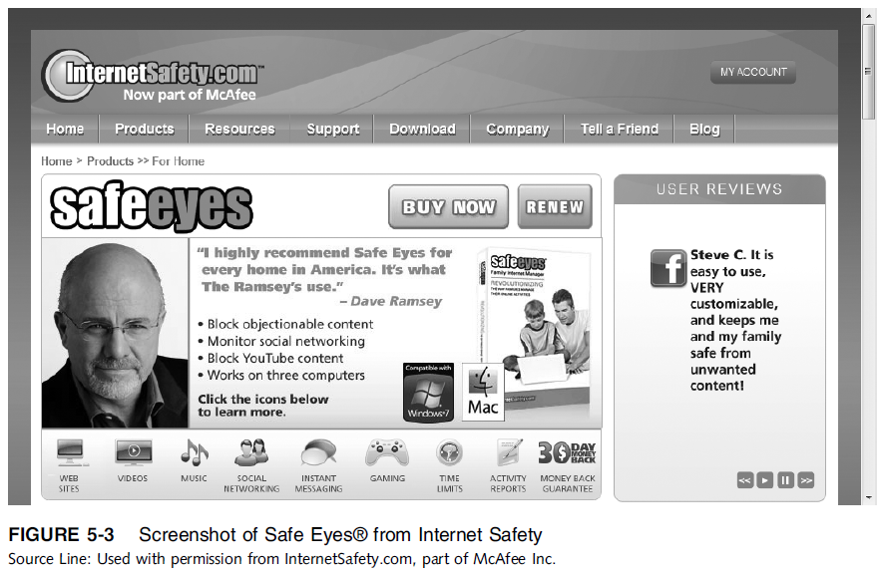
Ethics in Information Technology, Third Edition
Ethics in Information Technology,
‹#›
‹#›
Notes:
‹#›

Slide 12
Controlling Access to Information on the Internet (cont’d.)
URL filtering
Blocks objectionable URLs or domain names
Keyword filtering
Blocks keywords or phrases
Dynamic content filtering
Web site’s content is evaluated immediately before being displayed
Uses
Object analysis
Image recognition
Ethics in Information Technology, Fourth Edition
‹#›
Notes:
‹#›

Slide 13
Controlling Access to Information on the Internet (cont’d.)
Top-rated Internet filters for home users
NetNanny Parental Controls
PureSight PC
CYBERsitter
SafeEyes
CyberPatrol
Ethics in Information Technology, Fourth Edition
‹#›
Notes:
‹#›

Slide 14
Controlling Access to Information on the Internet (cont’d.)
ICRA rating system
Questionnaire for Web authors
Generates a content label
Platform for Internet Content Selection (PICS)
Users configure browsers to read the label
Relies on Web authors to rate their site
Complement to other filtering techniques
Ethics in Information Technology, Fourth Edition
‹#›
Notes:
‹#›

Slide 15
Controlling Access to Information on the Internet (cont’d.)
ISP blocking
Blocking is performed on the ISP server
ClearSail/Family.NET prevents access to certain Web sites
List is updated
Ethics in Information Technology, Fourth Edition
‹#›
Notes:
‹#›

Slide 16
Children’s Internet Protection Act (CIPA)
Federally financed schools and libraries must block computer access to:
Obscene material
Pornography
Anything considered harmful to minors
Ethics in Information Technology, Fourth Edition
‹#›
Notes:
‹#›

Slide 17
Children’s Internet Protection Act (CIPA)
Schools and libraries subject to CIPA do not receive Internet access discounts unless they:
Put in place measures to filter pictures that are obscene, or are harmful to minors
Adopt a policy to monitor the online activities of minors
Adopt a policy restricting minors’ access to materials harmful to them
Ethics in Information Technology, Fourth Edition
‹#›
Notes:
What is the CIPA policy?
The protection measures must block or filter Internet access to pictures that are: (a) obscene; (b) child pornography; or (c) harmful to minors (for computers that are accessed by minors)

Slide 18
Children’s Internet Protection Act (CIPA) (cont’d.)
CIPA does not require the tracking of Internet use by minors or adults
Acceptable use policy agreement is an essential element of a successful program in schools
Signed by:
Students
Parents
Employees
Ethics in Information Technology, Fourth Edition
‹#›
Notes:
‹#›

Slide 19
Children’s Internet Protection Act (CIPA) (cont’d.)
Difficulty implementing CIPA in libraries because their services are open to people of all ages
Including adults with First Amendment rights
CIPA has been upheld as constitutional by U.S. Supreme Court (U.S. v American Library Association)
Ethics in Information Technology, Fourth Edition
‹#›
Notes:
‹#›

Slide 20
Anonymity on the Internet
Anonymous expression is expression of opinions by people who do not reveal their identity
Freedom to express an opinion without fear of reprisal is an important right in democratic society
Anonymity is even more important in countries that do not allow free speech
Played important role in early formation of U.S.
In the wrong hands, it can be a tool to commit illegal or unethical activities
Ethics in Information Technology, Fourth Edition
‹#›
Notes:
‹#›

Slide 21
Anonymity on the Internet
Before and during the American Revolution, patriots who dissented against British rule often used anonymous pamphlets and leaflets to express their opinions.
England had a variety of laws designed to restrict anonymous political commentary, and people found guilty
A famous case in 1735 involved a printer named John Zenger, who was prosecuted for seditious libel because he wouldn’t reveal the names of anonymous authors whose writings he published. The authors were critical of the governor of New York. The British were outraged when the jurors refused to convict Zenger, in what is considered a defining moment in the history of freedom of the press
Ethics in Information Technology, Fourth Edition
‹#›
Notes:
‹#›

Slide 22
Anonymity on the Internet
it took nearly 200 years for the Supreme Court to render rulings that addressed anonymity as an aspect of the Bill of Rights.
One of the first rulings was in the 1958 case of National Association for the Advancement of Colored People (NAACP) v. Alabama,
court ruled that the NAACP did not have to turn over its membership list to the state of Alabama.
The court believed that members could be subjected to threats
Ethics in Information Technology, Fourth Edition
‹#›
Notes:
‹#›

Slide 23
Anonymity on the Internet (cont’d.)
Anonymity is important for internet users – they maybe
Seeking help in online support groups
Reporting defects in manufacturer product
Taking part in sensitive discussion
Others oppose
Defamation
Fraud
Libel
Exploitation of children
Ethics in Information Technology, Fourth Edition
‹#›

Slide 24
Anonymity on the Internet (cont’d.)
Anonymous remailer service
Computer program that strips the originating address from the email message
Forwards the message to the intended recipient
Ensures no header information can identify the author
Keeps what is communicated anonymous
What is communicated and whether it is ethical or unethical, legal or illegal, is up to the sender
Ethics in Information Technology, Fourth Edition
‹#›

Slide 25
Anonymity on the Internet (cont’d.)
Anonymous remailer service
An organization’s IT department can set up a firewall to prohibit employees from accessing remailers or to send a warning message each time an employee communicates with a remailer
Ethics in Information Technology, Fourth Edition
‹#›

Slide 26
Anonymity on the Internet (cont’d.)
John Doe lawsuit
Business must protect against
Public sharing of opinion that hurt its reputation
Public sharing of confidential information
Hard to identify person
John Doe lawsuit can be filed against anonymous
Court can summon to appear in court
By court permission, plaintiff can serve subpoenas
ISP
Web site hosting firm
Ethics in Information Technology, Fourth Edition
‹#›
Notes:
‹#›

Slide 27
Anonymity on the Internet (cont’d.)
John Doe lawsuit
Defendant communicates anonymously so identity of defendant is temporarily unknown
Common in Internet libel cases
the plaintiff can request court permission to issue subpoenas to command a person to appear under penalty
If court permission, plaintiff can serve subpoenas to third party
Few examples to follow
Ethics in Information Technology, Fourth Edition
‹#›
Notes:
‹#›

Slide 28
Anonymity on the Internet (cont’d.)
John Doe lawsuit
For example, Raytheon filed a lawsuit in 1999 for $25,000 in damages against 21 John Does for allegedly revealing on a Yahoo! message board company financial results along with other information that the company claimed hurt its reputation. Raytheon received a court order to subpoena Yahoo! and several ISPs for the identity of the 21 unnamed defendants. Eventually, Raytheon traced the identities of all 21 people who posted the alleged company secrets. Four employees voluntarily left the company, and others received counseling about sharing confidential company information.
Ethics in Information Technology, Fourth Edition
‹#›
Notes:
‹#›

Slide 29
Anonymity on the Internet (cont’d.)
John Doe lawsuit
America Online, Verizon Online etc receive more than 1000 subpoenas per year
Free speech advocates that if someone charges libel, their identity should be hidden until proved
stock price manipulators can use chat rooms to affect the share price of stocks
competitors of an organization might try to create the feeling that organization is a miserable place to work
Ethics in Information Technology, Fourth Edition
‹#›
Notes:
‹#›

Slide 30
Anonymity on the Internet (cont’d.)
John Doe lawsuit
The California State Court in Pre-Paid Legal v.Sturtz et al. set another legal precedent that refined the criteria that the courts apply when deciding whether or not to approve subpoenas requesting the identity of anonymous Web posters. The case involved a subpoena issued by Pre-Paid Legal Services (PPLS), which requested the identity of eight anonymous posters on Yahoo!’s Pre-Paid message board. Attorneys for PPLS argued that it needed the posters’ identities to determine whether they were subject to a voluntary injunction that prevented former sales associates from revealing PPLS’s trade secrets. ……
Ethics in Information Technology, Fourth Edition
‹#›
Notes:
‹#›

Slide 31
Anonymity on the Internet (cont’d.)
John Doe lawsuit
The Electronic Frontier Foundation (EFF) represented two John Does. EEF argued that they just criticized the company and their treatment with sales person. And they did not reveal any trade secrets. Also the company may punish them and set precedent for others to not to criticize. EEF urged the court to apply four-part test.
Ethics in Information Technology, Fourth Edition
‹#›
Notes:
‹#›

Slide 32
Anonymity on the Internet (cont’d.)
John Doe lawsuit
Subpoena should be enforced only when
The subpoena was issued in good faith and not for any improper purpose. • The information sought related to a core claim or defense. • The identifying information was directly and materially relevant to that claim or defense. • Adequate information was unavailable from any other source.
August 2001, a judge in Santa Clara County Superior Court invalidated the subpoena to Yahoo! requesting the posters’ identities
Ethics in Information Technology, Fourth Edition
‹#›
Notes:
‹#›

Slide 33
Defamation and Hate Speech
Hate speech that can be prosecuted includes:
Clear threats and intimidation against specific citizens
Sending threatening private messages over the Internet to a person
Displaying public messages on a Web site describing intent to commit acts of hate-motivated violence against specific individuals
Libel directed at a particular person
Ethics in Information Technology, Fourth Edition
‹#›
Notes:
‹#›

Slide 34
Defamation and Hate Speech (cont’d.)
annoying, critical, offensive speech protected
Legal liability when
Threats
Intimidation against specific person
ISPs reserve the right to remove data that is not up to their standards
AOL set of standards guidelines
Not responsible for delay or failure in removing
AOL has right to enforce them
Ethics in Information Technology, Fourth Edition
‹#›
Notes:
‹#›

Slide 35
Defamation and Hate Speech (cont’d.)
Such actions do not violate the subscriber’s First Amendment rights because these prohibitions are in the terms of service
ISPs must monitor the use of their service
Take action when terms are violated
Ethics in Information Technology, Fourth Edition
‹#›
Notes:
‹#›

Slide 36
Defamation and Hate Speech (cont’d.)
Public schools and universities are legally considered agents of the government and must follow the First Amendment prohibition against speech restrictions
Corporations, private schools, and private universities not part of state or federal government
May prohibit students, instructors, and employees from engaging in offensive speech
Example to follow
Ethics in Information Technology, Fourth Edition
‹#›

Slide 37
Defamation and Hate Speech (cont’d.)
Former student was sentenced to one year in prison for sending e-mail death threats to Asian American students at the University of California, Irvine. His e-mail was signed “Asian hater,” and his letters stated that he would make it his career to find and kill every Asian himself.
Ethics in Information Technology, Fourth Edition
‹#›

Slide 38
Defamation and Hate Speech (cont’d.)
Many countries don’t provide protection for hate speech
Promoting NAZI ideology is crime in Germany
Denying holocaust is illegal in European Countries
Thousands of people faced the potential of criminal charges after posting hate messages and threats to the Facebook account of Brendan Sokaluk, who is accused of setting bushfires that killed 21 people in Victoria, Australia, in February 2009. “It’s the cyber-world equivalent of angry mobs forming outside court, hurling abuse,” said Michael Pearce
Ethics in Information Technology, Fourth Edition
‹#›

Slide 39
Defamation and Hate Speech (cont’d.)
Across the borders
A U.S. citizen who posts material on the Web that is illegal in a foreign country can be prosecuted if he subjects himself to the jurisdiction of that country
He is safe in U.S
laws do not allow a person to be extradited for engaging in an activity protected by the U.S.
Even if the activity violates the criminal laws of another country
Ethics in Information Technology, Fourth Edition
‹#›

Slide 40
Corporate Blogging
Some organizations allow employees to create their own personal blogs to:
Reach out to partners, customers, and employees
Improve their corporate image
Discuss work-related issues
Invite others to refine or build new idea
Blogs can provide uncensored commentary and interaction
Criticism of corporate policies and decisions
Ethics in Information Technology, Fourth Edition
‹#›

Slide 41
Corporate Blogging
Could involve risk that employees might:
Reveal company secrets
Breach federal security disclosure laws
Guidelines
Don’t reveal company secrets
Make it appealing
Be interesting
Be authentic
Ethics in Information Technology, Fourth Edition
‹#›

Slide 42
Corporate Blogging
Mark Jen, an associate product manager for Google, began a blog chronicling his experiences at Google after his first day on the job. He thought his entries might be of interest to his family and friends. His entries candidly discussed his first day on the job, a global sales meeting, and Google’s compensation package. His comments also included information about Google’s future products and economic performance. Within a couple of days, Mark’s audience had grown into the tens of thousands.
Ethics in Information Technology, Fourth Edition
‹#›

Slide 43
Corporate Blogging
The following week, Mark’s blog was offline for a couple days. In his next posting, Mark revealed that he had been asked to take down sensitive information about the company. Then the entries stopped altogether, and rumors were rampant as the number of visitors to his blog approached 100,000 per day. A few weeks later, Mark finally checked back in to let his readers know that he had been fired. Within the blogosphere, Mark had become a cause célèbre, and Google’s reputation suffered. The incident sent a shock wave through the IT industry, forcing companies to evaluate and establish their own blogging policies.
Ethics in Information Technology, Fourth Edition
‹#›

Slide 44
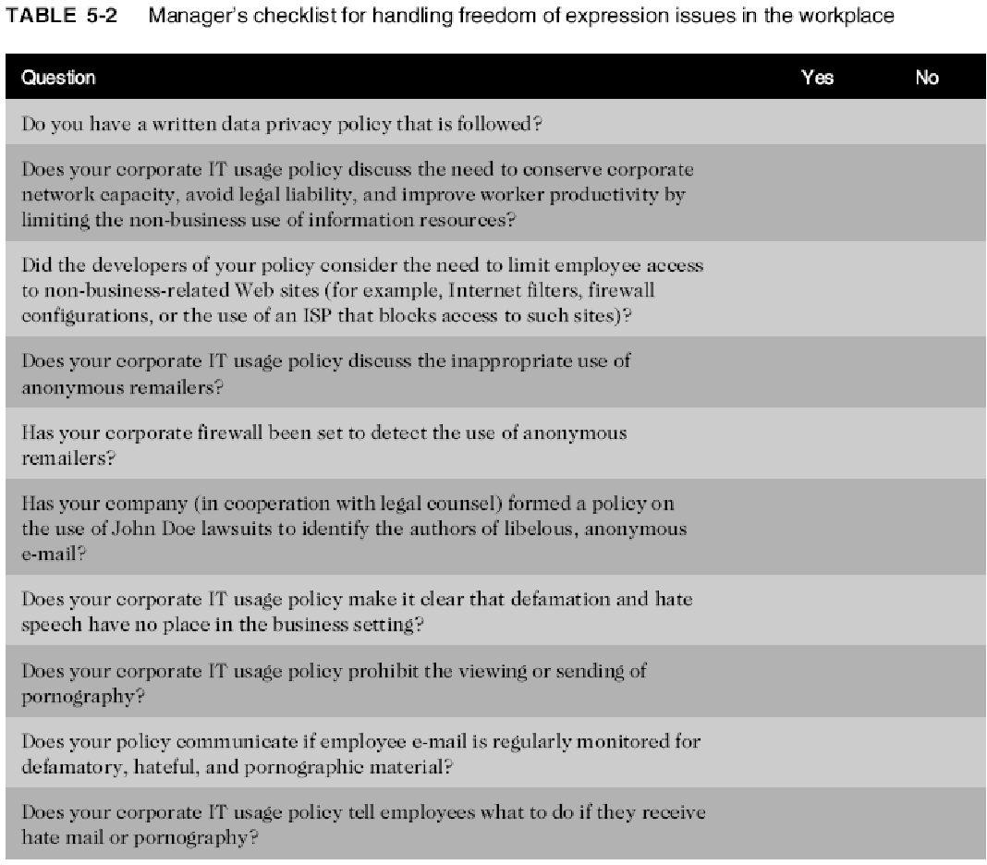
Ethics in Information Technology, Fourth Edition
‹#›
Notes:
‹#›

Slide 45
Summary
First Amendment protects the right to:
Freedom of religion and expression
Does not protect obscene speech, defamation
Key issues
Controlling access to Internet information, especially for children
Anonymous communication
Spread of defamation and hate speech
Access to pornography
CAN-SPAM Act limitations on email messages
Ethics in Information Technology, Fourth Edition
‹#›
Notes:
‹#›

